Slide 1

Exam Application System
Hao Senyue 116010062
Lao Guoyin 116010104
Mo Ziheng 116010169
Yang Yunteng 116010264

Slide 2
Students: enroll for exams
do some exercises
apply for universities
University: receive and response to students’ applications
Guardian: check upcoming exams
grade students’ answers
manage website exercises

Slide 3
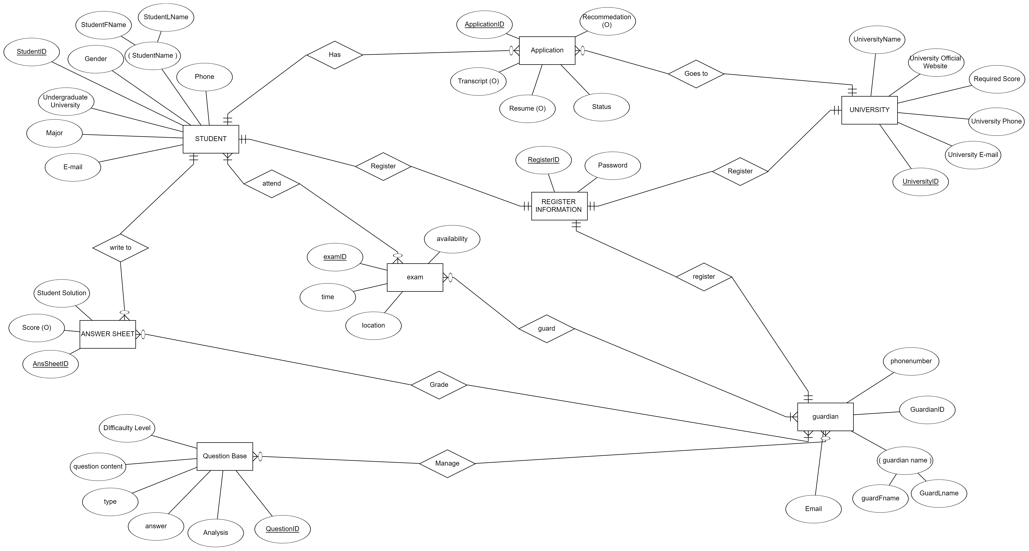

Slide 4

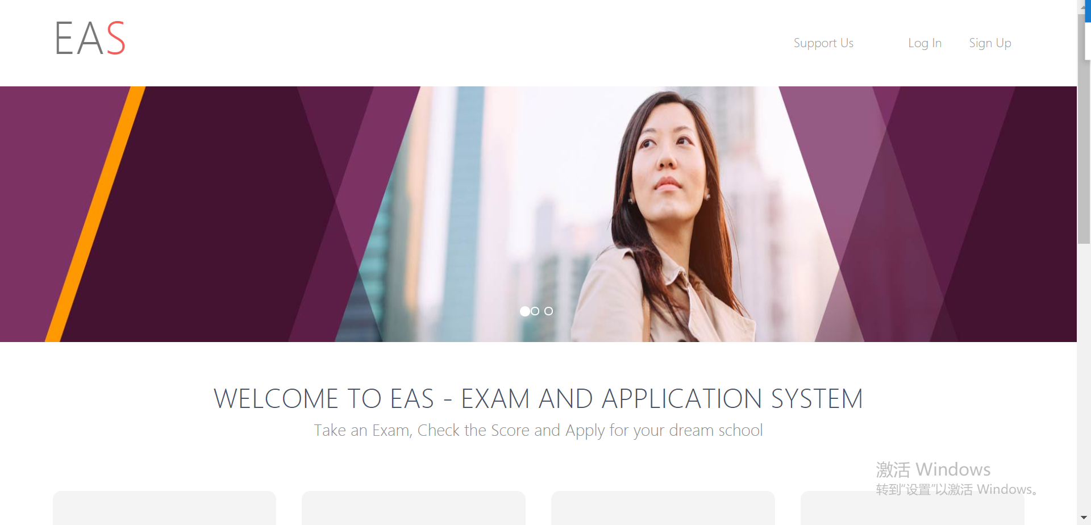

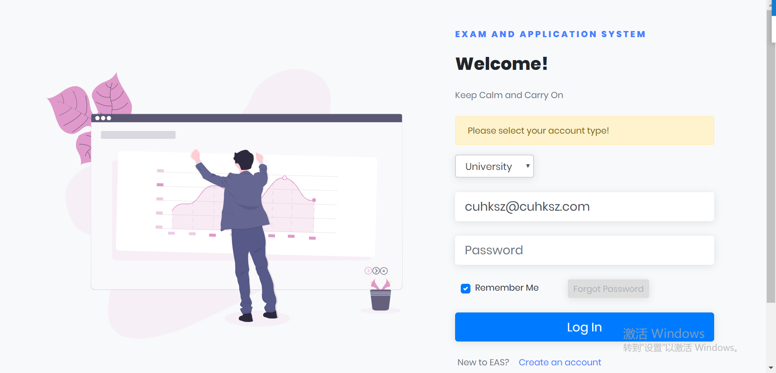
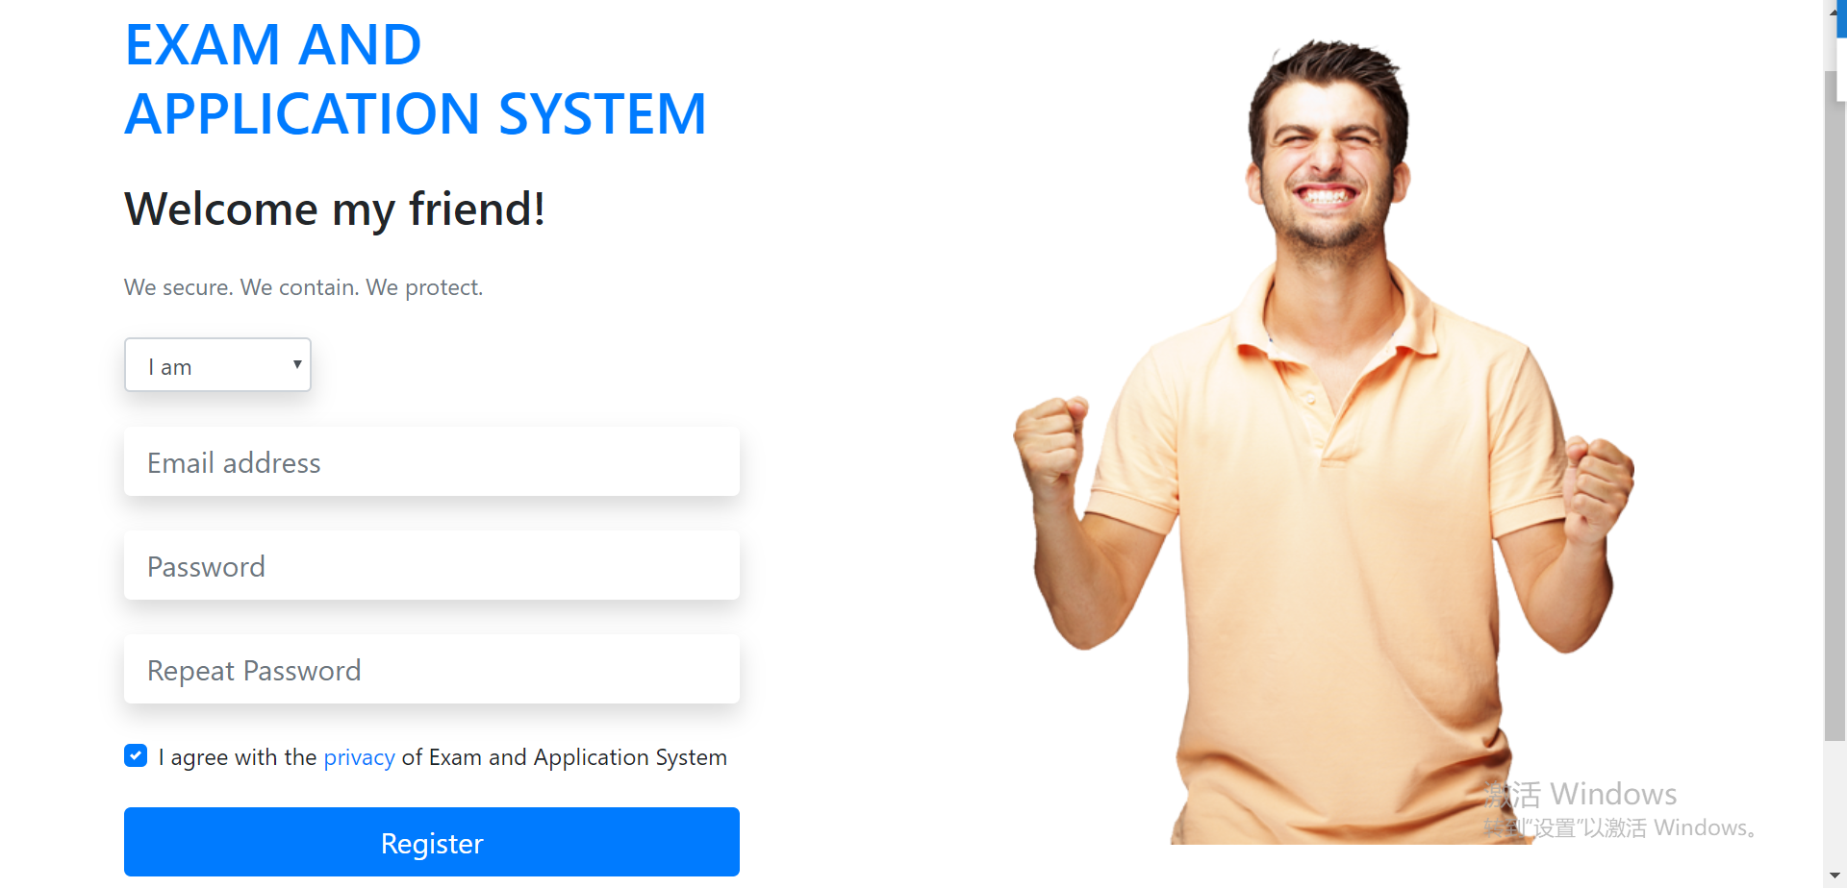


Front-end Design

Slide 5
What we have done
Database construction
Web Page design
Django connection
Server configuration

Slide 6
Show Time!

Slide 7
Thank you

